Slide 1
Minds, Machines, Persons
The Mind and Body: Part 2

Slide 2
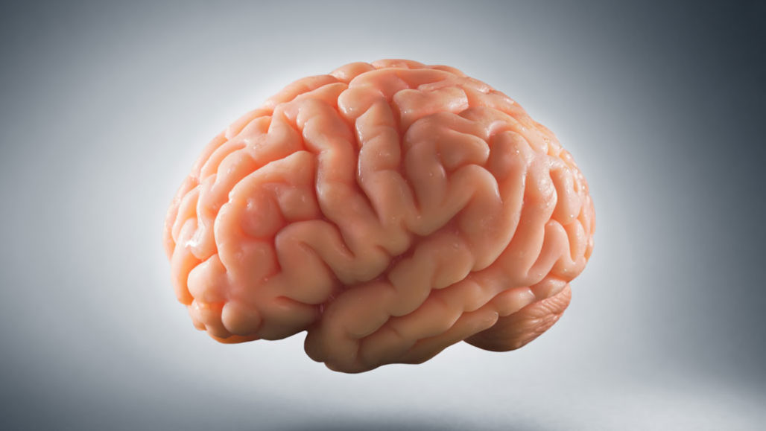
The Mind-Body problem
How is the mind connected to (or related to) the body?
May be reposed as the mind-brain problem
Conflicting intuitions
A) From the standpoint of modern science, it seems obvious that we’re made of matter
B) From the standpoint of our own conscious experiences, it seems implausible to think we’re made of matter
Sellars (scientific image vs. manifest image)
What science tells us about the world vs. what our experiences tell us

Slide 3
Theories of mind
Dualism vs. Materialism
Tell us what kind of thing the mind is
Immaterial or Material
Interaction vs. Non-interaction (e.g. epiphenomenalism)
Tells us more about the relation between the mind and the body
Do they communicate with each other?
If so, how?
Further questions: How do mental states represent?
Problem of intentionality
Note: This problem remains, even if we solve the mind-body problem!

Slide 4
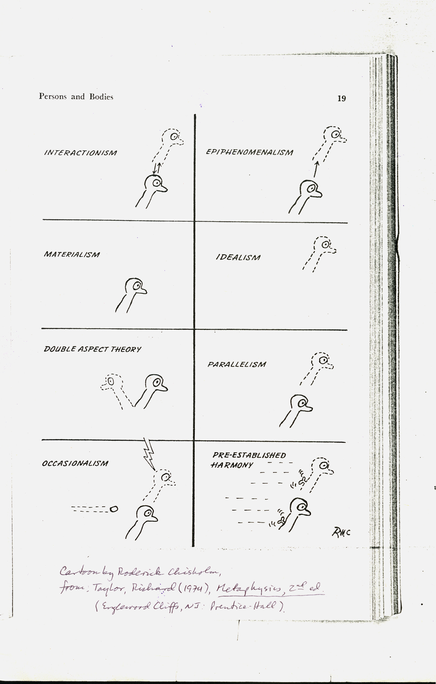

Slide 5
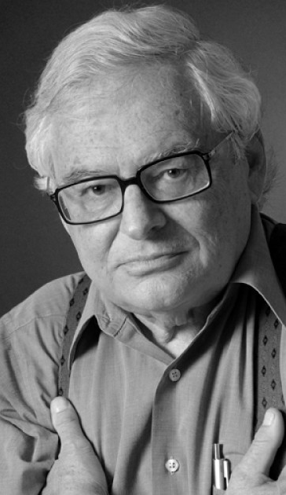
Jerry Fodor (1935-2019)
American Philosopher
Taught at Rutgers for over 30 years
Important contributions to philosophy of mind and cognitive science
Famous works: “Modularity of mind”, “Language of Thought”, “The mind doesn’t work that way”

Slide 6
“The Mind-Body Problem”
Appeared in a 1981 issue of Scientific American
Written for a popular audience
Fodor provides an overview and critique of philosophical theories of mind
Each of the theories faces its own kind of mind-body problem
a) Substance dualism
b) Behaviorism
c) Identity Theory
d) Functionalism

Slide 7
Difficulties with dualism
1) Causal interaction between mind and brain/body is inexplicable
How does something in space interact with something that is not in space?
Princess Elizabeth’s objection
2) Causal interaction between mind and brain would involve a violation of the laws of physics
“How can the nonphysical give rise to the physical without violating the laws of conservation of mass, of energy, and of momentum?”
3) No clear cases of interaction between a physical and nonphysical substance
Lots of clear cases of physical-to-physical interactions
4) How to account for the success of psychology
Cognitive psychology is doing a good job without positing the soul
How could psychology be a successful science if it’s target subject matter is not located in space and is nonphysical?

Slide 8
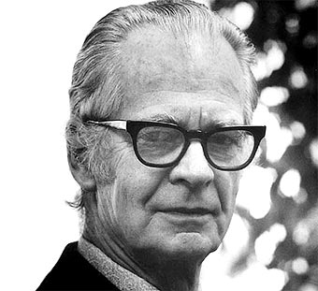
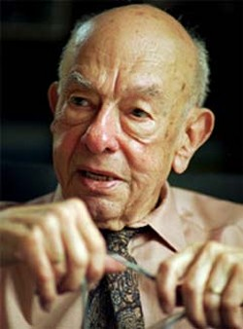

Behaviorism
Behaviorists are materialists about the mind
Popular theory (in psychology and philosophy) during first half of 20th century
The view which states minds and mental states can be reduced to behaviors or dispositions to behave
Methodological claim: Psychologists should just study the behavior of humans
Cannot scientifically verify the existence of mental states and minds (problem of other minds)
Introspection is an unreliable and unscientific method
Semantic claim: Talk of internal states (e.g. beliefs, perceptions, pain) is unnecessary (terms can be eliminated from the vocabulary of psychology)
Psychological terms can be translated into behavioral hypotheticals
Tom fears spiders=If Tom encounters a spider, then Tom will scream and run away
Metaphysical claim*: Mental states and causes don’t exist
They are just a shorthand way to refer to behavior
Same behavior=Same psychology
Much more radical view!

Slide 9



Slide 10
Problems with behaviorism
Behaviorism is false
Same behavior, different psychology (acting as if one is in pain vs. being in pain)
Same psychology, different behavior (Super Spartans | c.f. Putnam)
“P1. If behaviorism is true, it is not possible for there to be a perfect actor or doppelgänger who behaves just like me but has different mental states or none at all.
P2. But it is possible for there to be a perfect actor or doppelgänger who behaves just like me but has different mental states or none at all.
P3. Therefore, behaviorism is not true. (by modus tollens)” (IEP)
Notes:
Imagine a community of“super-spartans’ or ‘super-stoics’ — a community in which the adults have the ability to successfully suppress all voluntary pain behavior. They may, on occasion, admit that they feel pain, but always in pleasant well-modulated voices ...They do not wince, scream, flinch, sob, grit their teeth, clench their fists, exhibit beads of sweat, or otherwise act like people in pain. They do not even report that they are in a state of pain for it would be a disgrace to the family. However, they do feel pain, just as we do and they dislike it” Is this logically possible? If so, then behaviorism is false

Slide 11
Other problems with behaviorism
Behaviorism failed as a research program, cognitive psychology succeeded
Psychologists in the 1950’s and 60’s reintroduced mental states and processes to explain a wide range of psychological phenomena (e.g. rat navigation, language acquisition)
Success of cognitivist framework is what you would expect if mental states are real
Fodor: Behaviorism only popular because the only alternative at the time was belief in ghosts and spirits (i.e. substance dualism)
Instead of resorting appeals to the supernatural, early psychologists bit the metaphysical bullet on behaviorism (guess there is no mind…)

Slide 12
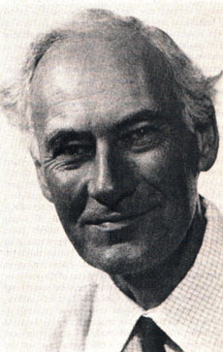


The shift to Identity Theory
Minds and mental states should be understood as internal causes of our behavior
Internal causes are physical mechanisms
Def. the view which states that mental states, and properties are identical to brain states and biochemical properties
“Sensations are nothing over and above brain processes.” (J.J.C Smart)
1-1 mapping between types of brain states and types of mental states
Smart thinks there are sensations, but that they are identical to brain processes
Not something distinct
Also an instance of materialism
Everything is made up of matter

Slide 13
Type/Token Distinction
Types are abstract and unique
Types of music (genres)
Types of words (‘cat’, ‘dog’, ‘water’)
Tokens are concrete particulars
Tokens of words: “Dog, dog, dog”
Three tokens of the same type
How many courses have you taught?
Course types or tokens?

Slide 14
Type/Token Identity
Type Identity: Types of mental states are identical to types of brain states
Token identity: A particular mental state is identical to some particular physical state
Type identity: All beliefs have the same underlying neurophysiology (e.g. B fibers)
In order to have a belief, you must have B-fibers
Unique identification
Token identity: In order to have a belief, you must have a nervous system
Neutral on the type of physical structure (Carbon-based brain, Silicon-based computer)
Both versions are incompatible with substance dualism (They’re a version of materialism/physicalism)
Token identity is entailed by type identity (but not the other way around)

Slide 15


Examples of identity
Water=H20
Light=Electromagnetic radiation
Morning star=evening star (Venus)
Superman=Clark Kent
Smart: Pain=C-fibers firing
Identities need to be discovered
Empirical investigation, not conceptual analysis
You can be wrong about identifications

Slide 16
Arguments for identity theory
Argument from the unity of science
Every other phenomenon can be accounted for by laws of nature and physical mechanisms
Why should psychology be completely different? (J.J.C Smart)
Conclusion: Psychological entities and properties will one day be understood in within this framework (the mechanical mind thesis)
Argument from simplicity
Identity theory is simpler than its dualistic competitors
No need to posit the existence of an immaterial soul or nonphysical properties to explain mentality
Therefore, identity theory should be preferred
We should prefer simpler theories in science and philosophy (Occam’s Razor)

Slide 17
Objections to Identity Theory
Leibniz law: If A=B, then whatever is true of A is also true of B
Descartes: Logically possible for the mind to exist without the brain (conceivability argument) Therefore, the mind and brain must be distinct things (they cannot be identical!)
Smart: Not logically possible if identity theory is true (challenge to the conceivability argument)
Morning star and the evening star
Possible that you could have water without H20?
Takeaway: Conceivability might not always be a reliable guide for possibility (identity claims as a potential counterexample)

Slide 18
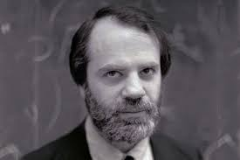
Conceivability Argument (2.0)
Saul Kripke’s version
P1. If pain is identical to C-fiber activation, then whenever someone feels pain, they must have C-fiber activation
P2. But it’s possible for someone to feel pain without having C-fiber activation
C. Therefore, pain is not identical to C-fibers
Support for P2?
Claim about logical possibility
Empirical support: Phantom limb syndrome? (Pain without C-fiber activation)
Response: Maybe those individuals are having a pain hallucination
Counter: Pain is just a kind of feeling. If you feel it, you’re in pain
Pain hallucinations aren’t coherent

Slide 19
Explaining the mind
Theory of mind should explain how all minds work, not just the minds of humans
Nonhuman animals: octopuses, dogs, chimpanzees, fish
Extraterrestrials: Non-carbon-based lifeforms with different brains
AI robots
The (type) identity theorist claims that mental states require certain neurological structures (C-fibers, neocortex, etc.)
Neurological structures found in humans
Criticism of Identity theory:
Too restrictive
Pain=the firing of C-fibers
Maybe true of human minds, but what about creatures that don’t have C-fibers? Can’t feel pain?
Fodor: We should prefer a theory which allows for the possibility of mental states in creatures that are unlike us, biologically speaking

Slide 20

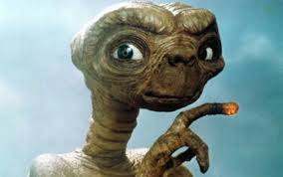
Multiple realization
What if aliens feel pain by way of some radically different physical mechanisms?
Neural structures very different than those found here
Perhaps they feel pain without even having a brain or central nervous system
If true, you would have different ways to realize mental states
The multiple realization hypothesis
If the multiple realization hypothesis is true, then identity theory is false
Pain wouldn’t be identical to C-fibers
Pain would be multiply-realized
But there is still something in common between all creatures that feel pain
Suggests a theory of mind that has more generality

Slide 21
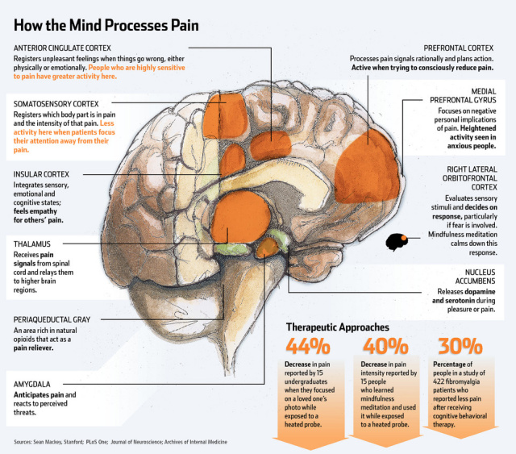
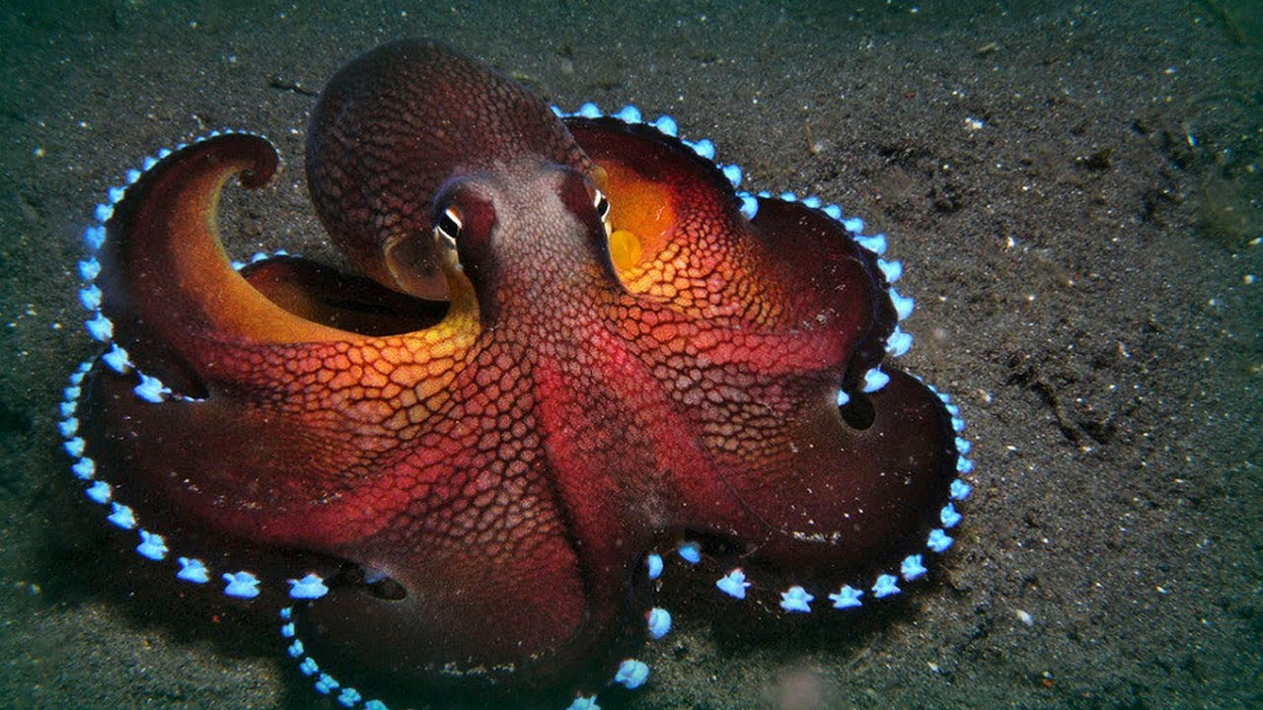
Evidence for multiple realization thesis
Aliens and future robots are merely hypothetical confirmations of the multiple realization hypothesis
The philosopher Hilary Putnam argues that there are real world examples:
P1. Other animals probably feel pain (e.g. octopuses)
P2. But not all animals that feel pain have brains like ours (same pain, different brain)
C. Therefore, pain is not identical to some type of brain state
Identity theory is false

Slide 22
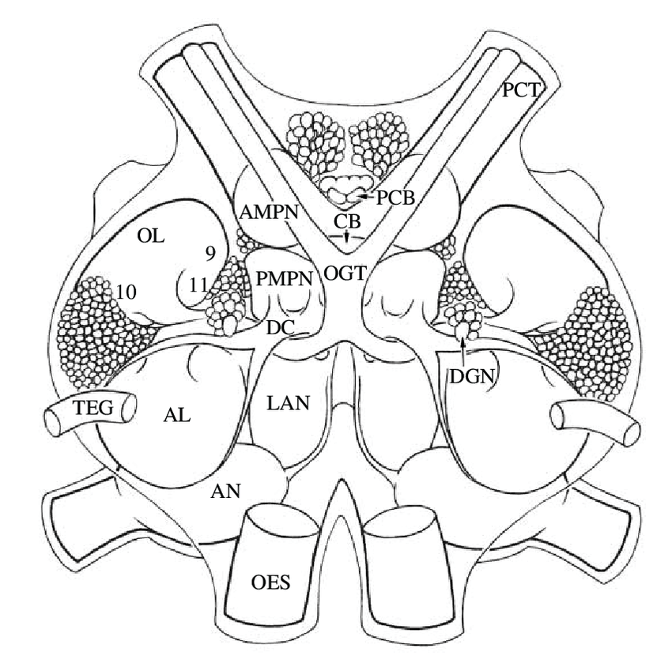
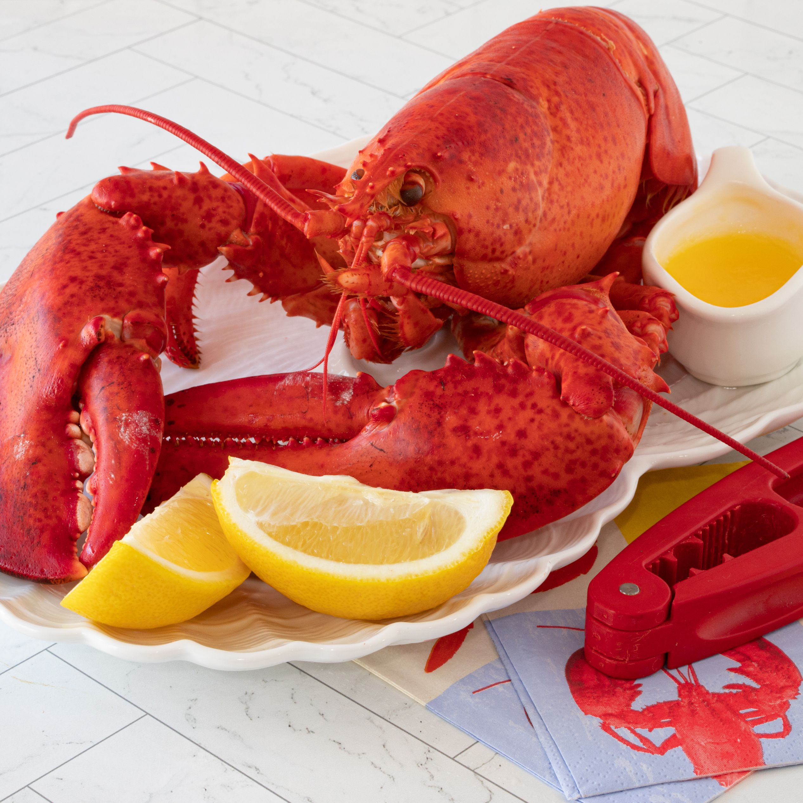
Responses to the threat of multiple realization
Identity theorists: There are no compelling examples in the real world
Empirical question whether multiple realization is possible
Philosophers cannot settle this dispute in the armchair
If some creature behaves like it’s in pain, but has a very different brain than ours, then we should infer that it is not actually experiencing pain

Slide 23
Functionalism at a glance
Def. the view that mental states and events are defined by their causal relations to other mental states, stimuli (inputs), and responses (outputs)
Most widely held theory of mind among cognitive scientists
Also very popular among philosophers
Developed by Hilary Putnam in the early 60’s
Functionalists do not specify what the mind is made up of
Mental states are given a functional description and defined by their causal roles (the effects they have on other parts of the system)
The mind is treated as a black box
To understand how functionalists analyze minds and mental states, we should look at simpler cases

Slide 24
Understanding machines
According to the mechanical mind thesis, mental phenomena can be understood as mechanisms or machines
To understand a machine, you need to understand what it does
What is it used for?
What does it do?
Rarely will you need to know what kinds of materials are used to make the machine
Machine could be made from many kinds of materials
More than one design plan could be used
Functional properties can be realized in more than one way
Realized: made into a specific tangible object
Multiply realizable

Slide 25
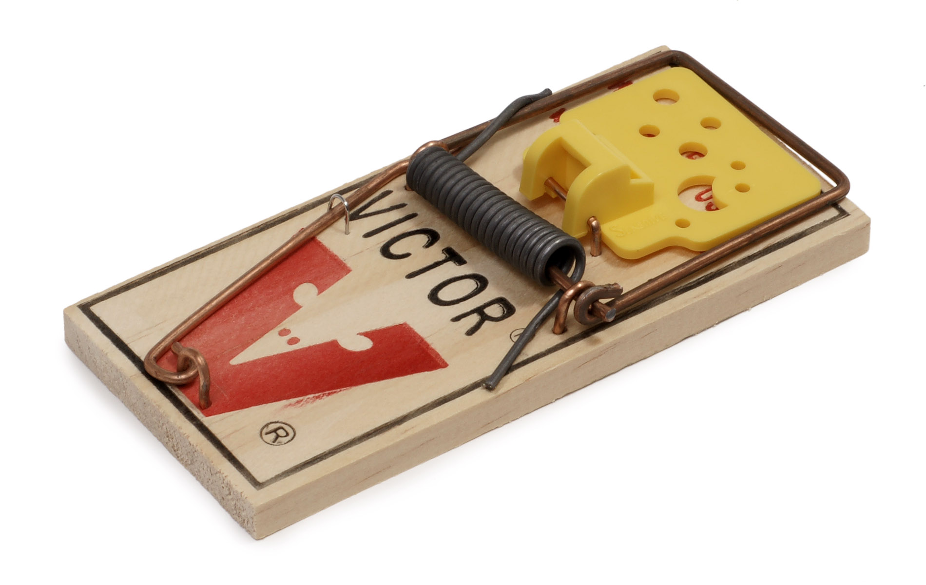
How fans and mouse traps work
To understand how a fan works, you don’t need to know whether it’s made of plastic or metal
Specify the functional properties (what the things does) without saying anything about physical properties
You can talk about the mechanisms or parts in the abstract (you have a lever and some bait)
Mouse traps
Function: trapping mice
Different designs
Glue trap vs. Spring trap
Function of a fan (causal role): to move air around
Different kinds of fans (paper fan, box fan, ceiling fan)
Made of different materials (plastic, metal)

Slide 26
Understanding the machine
Don’t need to know whether it was made of aluminum, steel, or brass
Don’t need to know if the thermostat is realized by liquid mercury or a silicon chip
We can abstract away from what it’s made of and still understand what it is
Functionalists argue that this is the best way forward for understanding the mind
Metaphysical questions can be sidestepped (physical or nonphysical substance?)
Functional analysis of mental phenomena (what do they do?) should be the goal of cognitive science
Analysis should be true, whether the mind turns out to be physical or nonphysical

Slide 27
Functionalism
Provides an account of what mental state terms mean (semantic claim)
Insight: in order to understand how the mind works, you don’t need to know what it’s made of
Need to know how the mind functions
Functional roles for all mental states, mental capacities
What does each part of the mind do? What is the functional role of each mental state?
Black box model of the mind
Don’t need to know what’s inside the black box

Slide 28
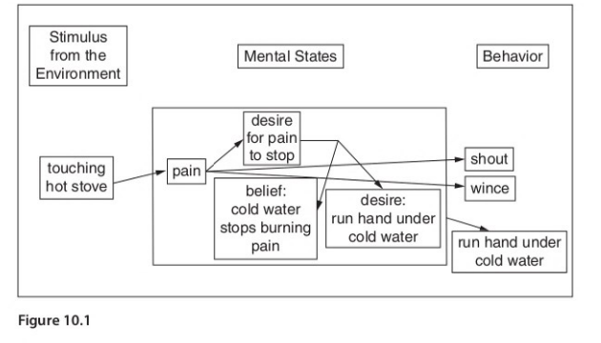
A functionalist account of pain
“a state that tends to be caused by bodily injury, to produce the belief that something is wrong with the body and the desire to be out of that state, to produce anxiety, and, in the absence of any stronger, conflicting desires, to cause wincing or moaning.”
For humans, suppose some kind of brain activity meets all of these conditions (e.g. C-fibers firing)
Pain is realized in the human brain via C-fibers firing (physical structures that instantiate pain)
Leaves open the possibility of multiple realizability
Some philosophers accept functionalism, but deny multiple reliability (Lewis)
Only one type of physical state that can exhibit this functional organization (the mammalian brain)

Slide 29
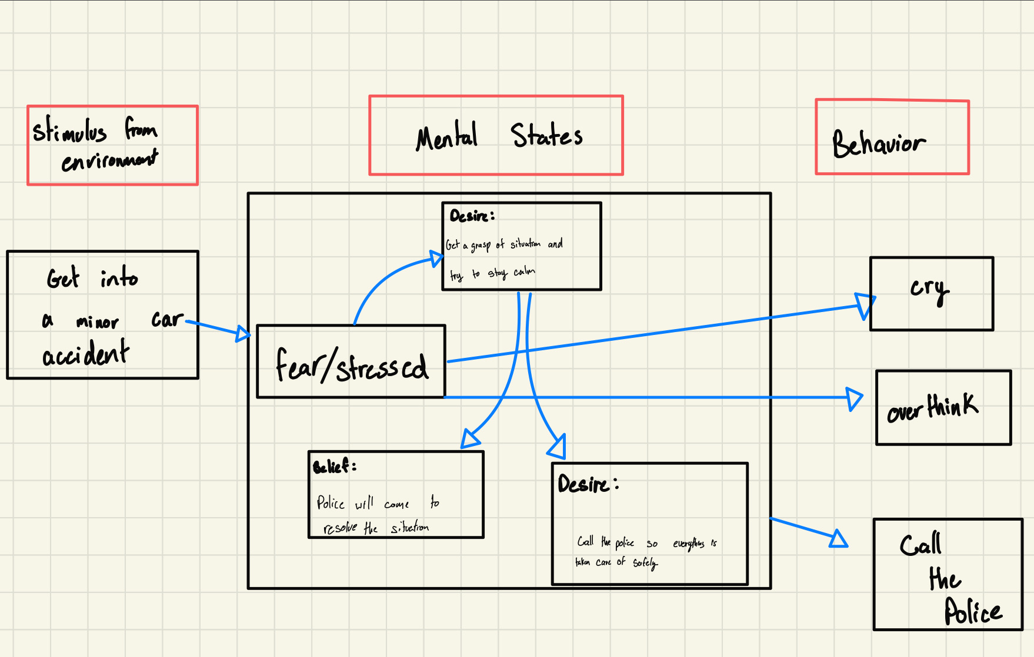

Slide 30
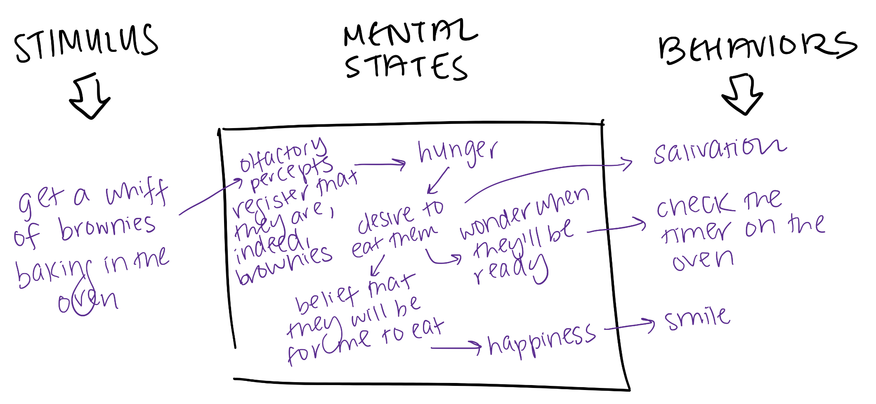

Slide 31
Functionalism and Multiple realization
Fodor: just like artifacts, mental states are probably multiply realizable
Possible that mental states are realized by multiple physical systems that differ from one another
Carbon based brain
Silicon based brain
The possibility of multiple realizability is a problem for identity theory, but is welcomed by functionalism
If there is more than one way to realize pain, then pain isn’t identical to any one type of physical state
The black box diagram captures this
Offers an accurate description of the functional roles for any being undergoing that mental state

Slide 32
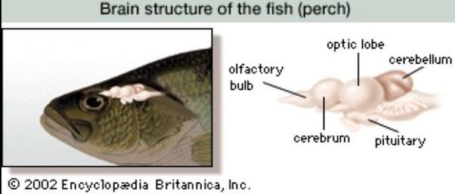
Real world application
Do fish feel pain?
Neuroscientist: Brian Key: Nope. Brains aren’t similar enough to our own
Philosopher Peter Godfrey-Smith: Can’t rule out multiple realization thesis
Fish brains might carry out the function of feeling pain some other way
Functional roles carried out by different neurological structures (same mental state, different brain)

Slide 33
Fish pain debate
Neuroscientists like Key are implicitly committing themselves to a type identity thesis about pain
In order to feel pain, you must have brain state X
Philosophers like Godfrey-Smith appealing to functionalist views of the mind
Multiple realization of pain
Pain in fish (brain state y)
Pain in humans (brain state x)
Way to resolve debate
Study the brain of the octopus
Pain behaviors is the octopus are more detectable than in fish
Why do they behave like mammals and birds when they are injured?

Slide 34
Objections to Functionalism
Problem #1: It’s possible for two subjects to have the same mental states with different experiential content
Inverted Spectra
Problem #2: Functionalism is overly permissive
Tells us that any system with the same functional (causal) organization as the human mind will be psychologically the same as the human mind
The Chinese Nation thought experiment

Slide 35
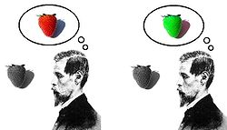
Inverted Spectra
If this is logically possible, then functionalism would have to say that both individuals are undergoing the same mental state
But that’s not right
Therefore, something is wrong with functionalism
Notes:
that two individuals might think and behave in the same way yet have different conscious experiences of color. Their mind functions the same way, but they have different subjective experiences. The traditional supposition is of an individual who has a subjective color spectrum that is inverted with regard to that had by other individuals. When he looks at red objects, this individual has the qualia normally produced in others by green objects. And when presented with a green object, this individual experiences qualia that most persons experience only when presented with red objects. And so forth - the Invert's color spectrum is the inverse of normal; there are systematic inter-subjective differences in qualia.

Slide 36
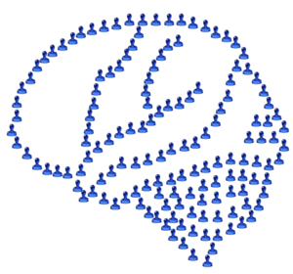
Chinese Nation
Imagine if we were to do the following:
A billion citizens carry out the causal roles that neurons play in our brains
Input and Output “neurons”
Communicate to one another through radio signals (axons and dendrites)
Hooked up to one another in the appropriate ways
Functional organization of the “system” is identical to the functional organization of the mind
Would such a system (not just the parts that make it up) have mental states and be conscious?

Slide 37
Responses to Chinese Nation
The intended intuition: Implausible that the Chinese nation would have a mind
Ned Block and John Searle: It wouldn’t be because there is something special about brains or biology that would be missing
Putnam: The Chinese Nation would have a mind, as would any other system with the right configuration
Minds made out of ice cream
Minds made out of beer cans
Worry: Functionalism is too permissive a theory of mind
Allows for mental states to exist in systems that we don’t think could have minds
Response from functionalists
There could be limitations to realizing mental states, but not as many as the type identity theorist suggests
Minds probably cannot be made of ice cream and beer cans, but maybe they can be made of silicon chips

